Slide 1
Individually-varying, niche-based patterns of species foliar cover in Arctic Alaska
Major Funding from BLM Alaska
Timm Nawrocki, Alaska Center for Conservation Science
Notes:
I’m Timm Nawrocki, a vegetation ecologist at Alaska Center for Conservation Science and a graduate student at UAA. I’ll talk about a niche-based approach to mapping patterns of vegetation spatial variation.

Slide 2
Acknowledgements
Funding:
Scott Guyer - BLM Alaska State Office
Beth Schulz - USFS PNW Research Station
Database Design:
Jess Grunblatt - NSSI
Coauthors:
Matthew Carlson, Jeanne Osnas – ACCS
Jamie Trammell – Southern Oregon University
Notes:
Scott Guyer at BLM provided the major funding for this project. Beth Schulz at USFS provided additional funding related to development of a statewide vegetation plots database. And I want to recognize my coauthors on this study Matt Carlson and Jeanne Osnas at UAA and Jamie Trammell at SOU.

Slide 3
How do we SYNTHESIZE existing data to
describe terrestrial
vegetation?
Notes:
This project stems from a recognition by DOI agencies with lands in the arctic of the need to synthesize existing vegetation data across the region and integrate those field data with remote sensing data. Statistical inference from these data can answer specific questions that will enable natural resource managers to make informed decisions.
What are the locations, abundance, patterns, and trends of vegetation species and communities?
Where is forage for caribou and other Arctic herbivores?
Neither of these questions are answered well by traditional vegetation maps.

Slide 4
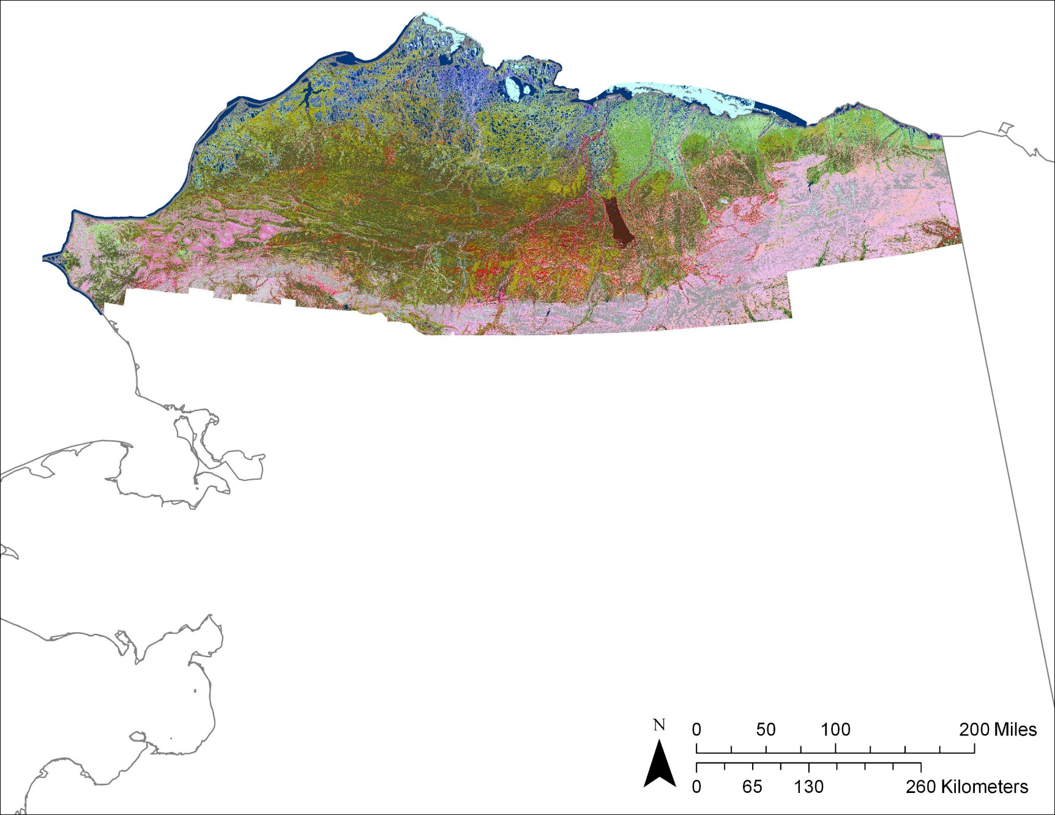
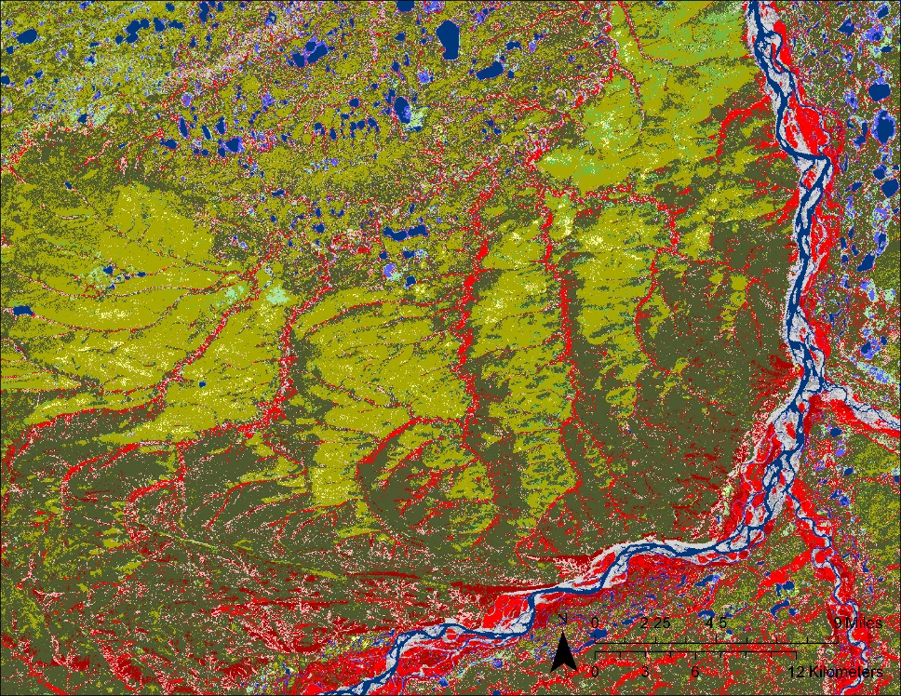
Discrete Type Mapping
Disadvantage of non-overlapping discrete types
Deterministic clusters
No internal structure
Abrupt discontinuities
Notes:
By traditional, I’m referring to non-overlapping discrete type vegetation maps, such as the North Slope Land Cover map shown. These maps have several assumptions: vegetation form deterministic clusters; clusters either have no internal structure or the internal variation is unimportant; the landscape is divided by a series of abrupt discontinuities.
All three of these assumptions are contradictory to the past 100 years of ecological theory.

Slide 5
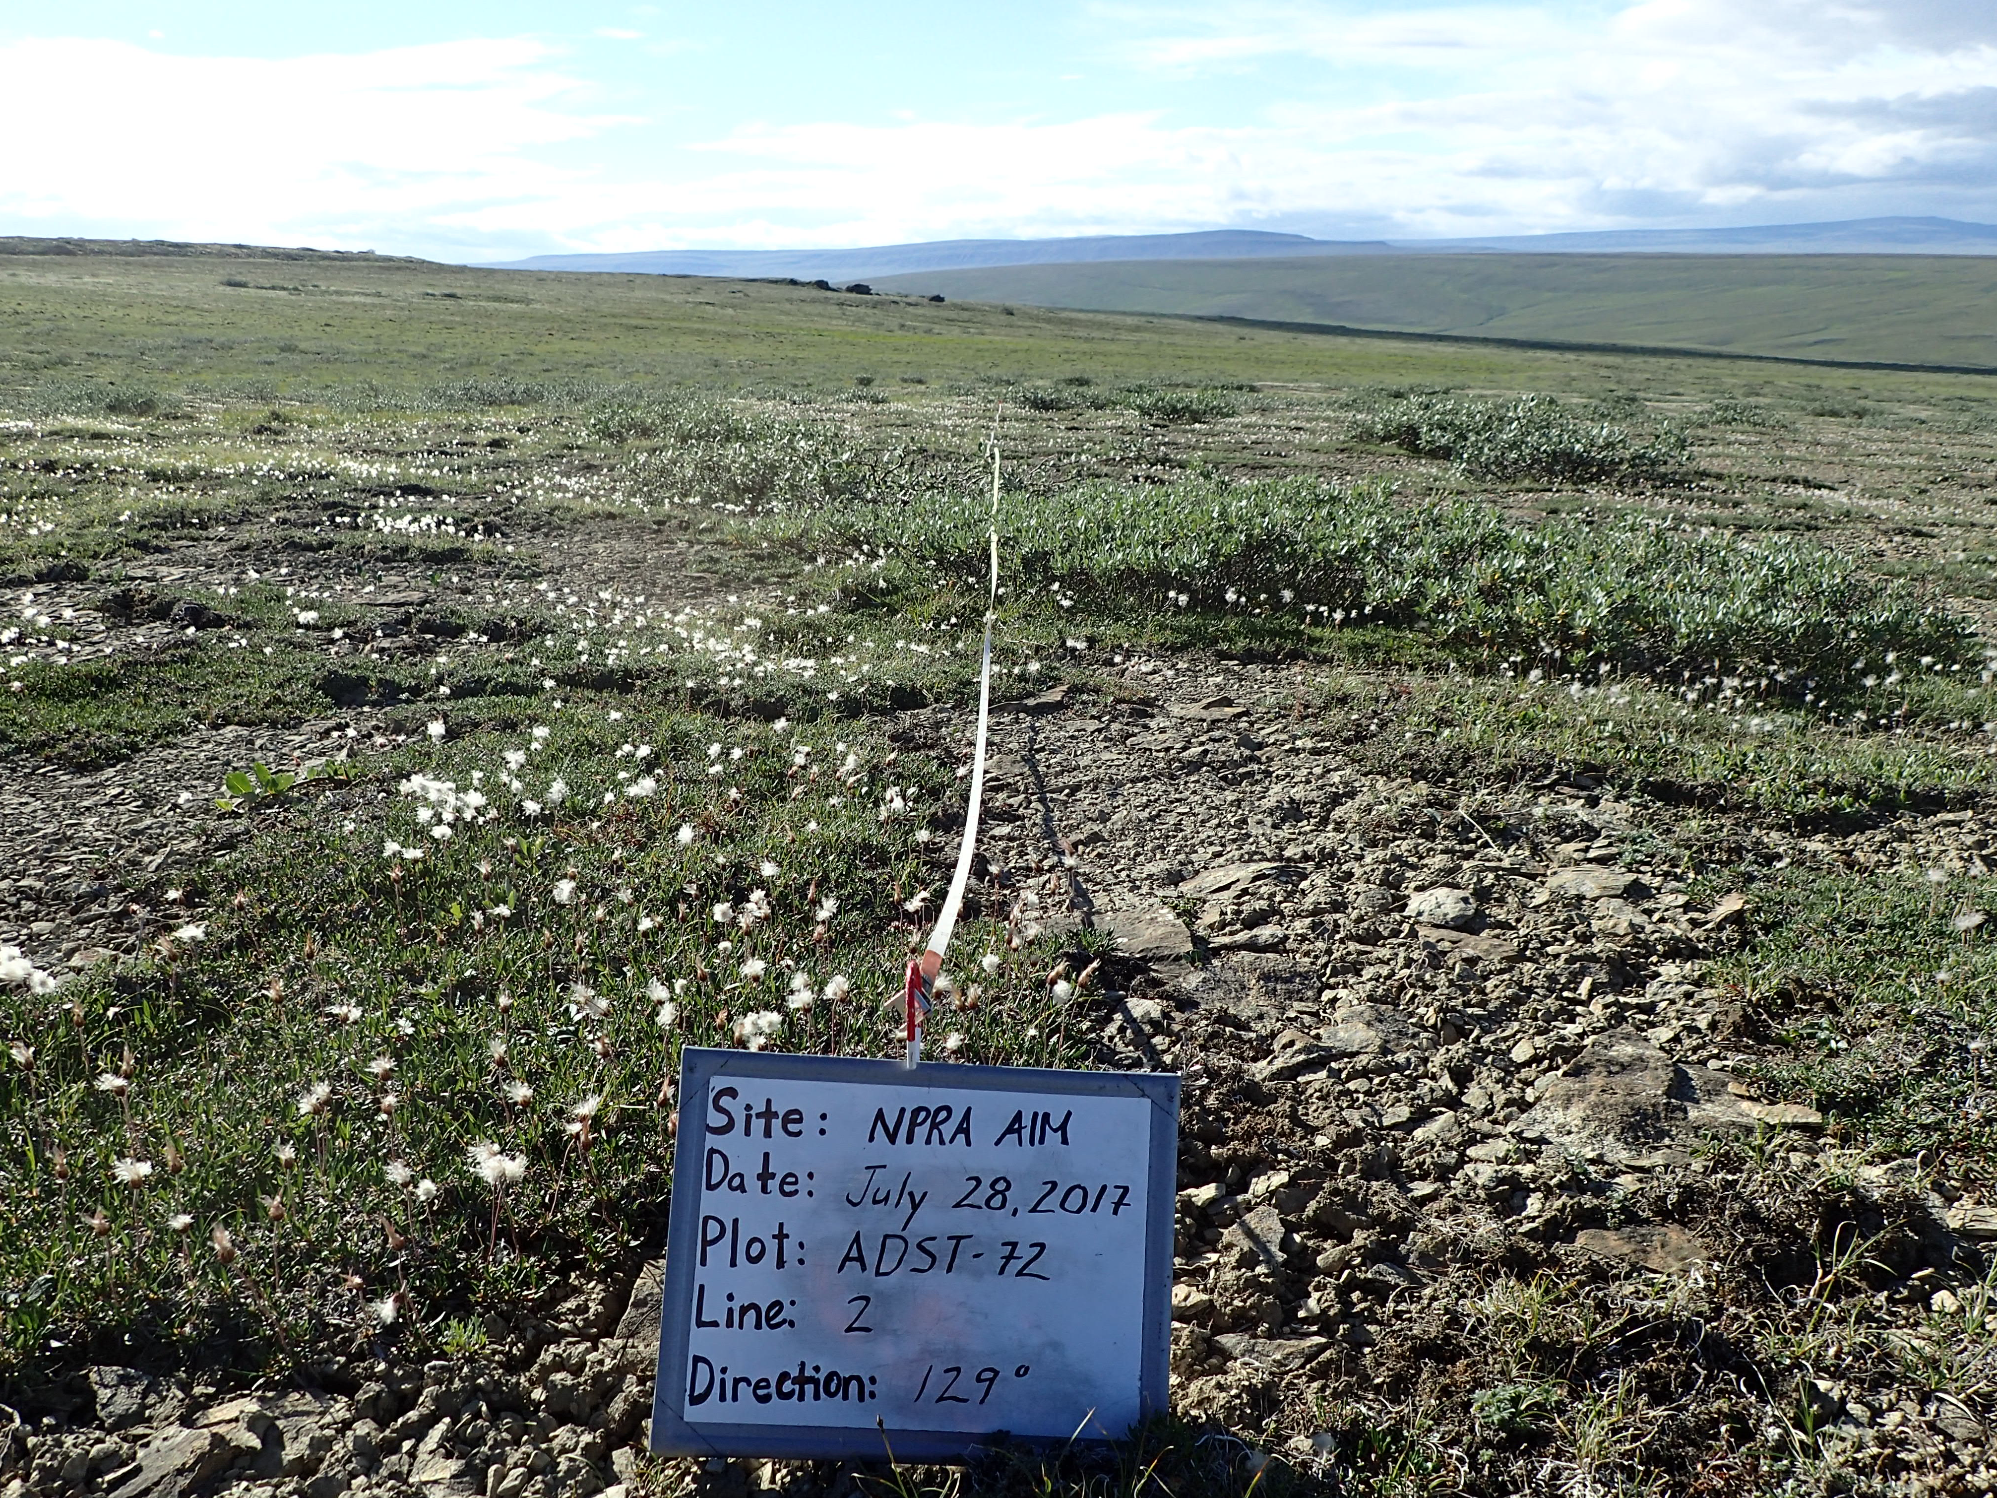
Niche-based Mapping
Gleason 1926, Whittaker 1967
Hutchinson 1957
Individualistic responses form plant communities
Species spatial patterns driven by environmental and biotic gradients in niche-space
Notes:
In 1926 Gleason hypothesized that individualistic responses form plant communities and Whittaker brought data to back that argument in 1967. Additionally, in 1957 Hutchinson hypothesized that species variation in physical space is driven by environmental and biotic gradients in niche space. These two axioms imply that species are the fundamental units by which environmental and biotic gradients drive spatial patterns, in addition to biohistorical factors, stochastic events, and dispersal limitations.
We should therefore map vegetation in a way that represents the variation of individual species, or, to say it another way, our maps should represent the realized niches of species. This photo shows one of our field sites from 2017 with high spatial heterogeneity at multiple scales. We broadly categorized this site as alpine dwarf shrub tundra, but you could potentially measure high foliar cover of Salix alaxensis here.

Slide 6
Gradient Paradigm
Natural variation
Information Loss
Abrupt discontinuity
Gradient
Discrete
Notes:
We also know that vegetation communities often do not have discrete boundaries and instead vary continuously through transitional forms. Discrete representations of continuous variables lead to information loss and the introduction of arbitrary thresholds that reflect the bias of particular ecologists rather than ecological phenomena.

Slide 7
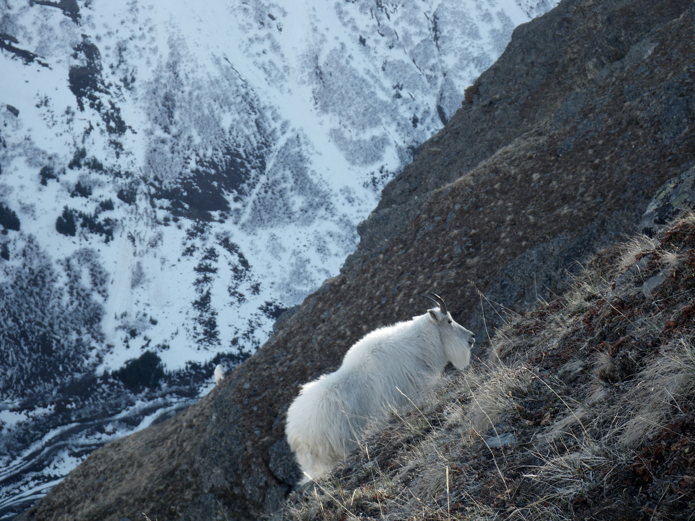
Notes:
For an example of how this relates to wildlife, if we think that the spatial heterogeneity in forage abundance and quality matters to herbivores, then we should move towards a mapping approach that predicts the spatial variation of forage species.

Slide 8
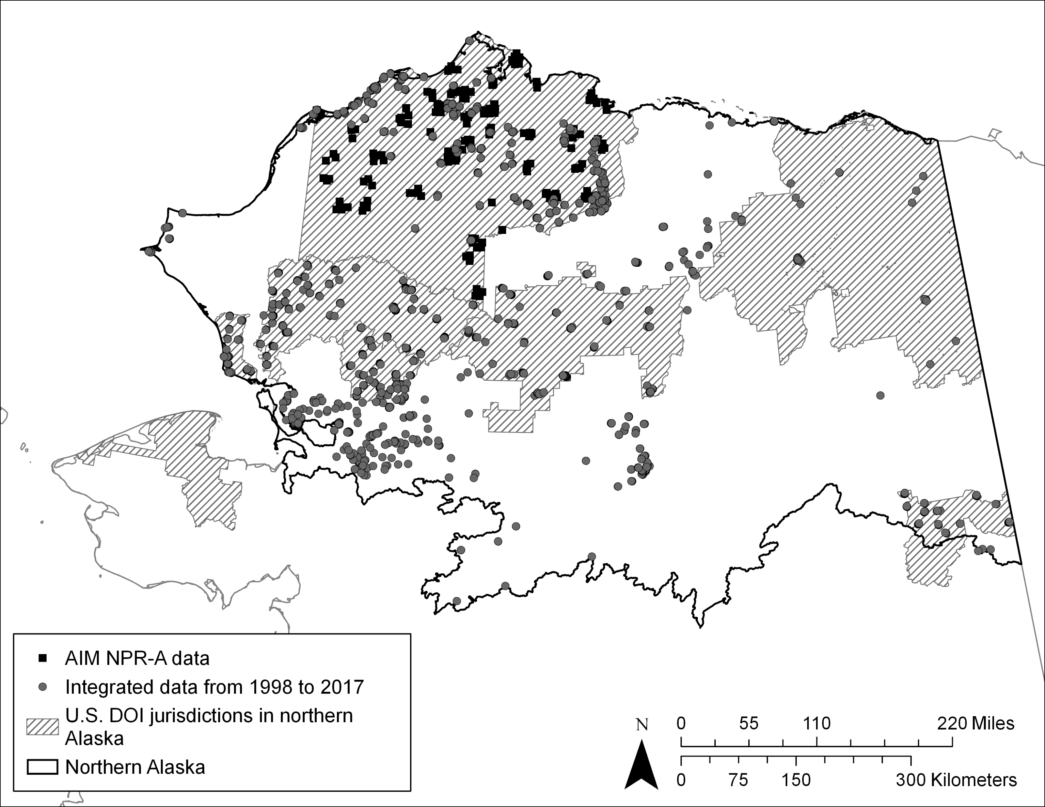
Vegetation Plots Database
Notes:
We collected vegetation and environmental characteristic data in NPR-A from 2012 to 2017 at 185 sites (represented in this map as black squares). We integrated these data into a standardized, web-hosted database with ground measurements from thirteen additional extensive vegetation monitoring and surveying datasets in northern Alaska (represented by grey circles). The data that we collected were the only data that were quantitative and comparable to the size of a landsat pixel.

Slide 9
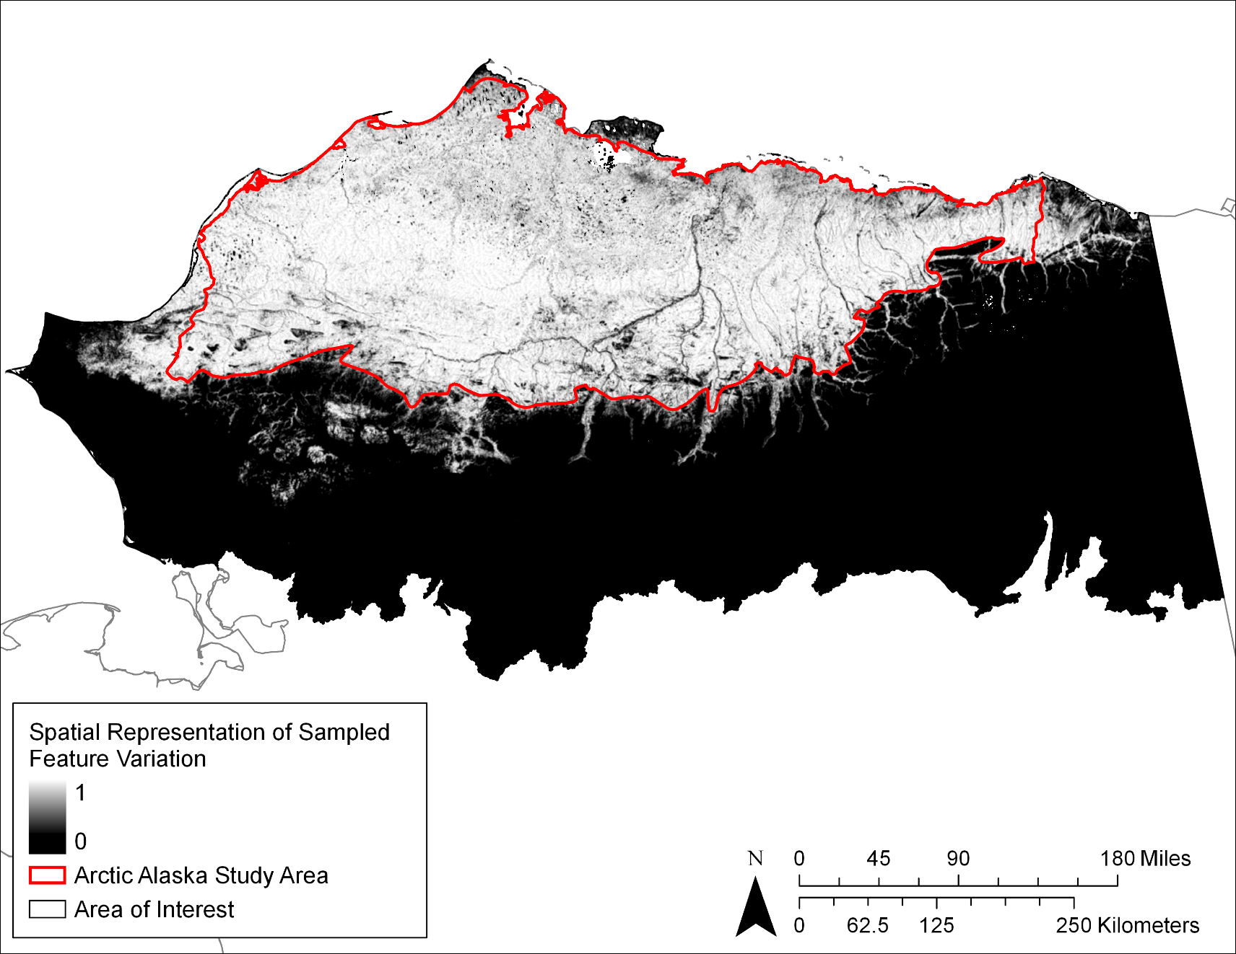
Study Area
Notes:
We defined our study area as the largest contiguous region where at least 50% of physical space within a 1.5 sq km moving grid was within the support vector in feature space that bounded 95% of our quantitative vegetation observations.
Our study area encompassed the Brooks Foothills and Beaufort Coastal Plain from the Kukpowruk River in the west to the Jago River in the East. This is the area within which we can make valid statistical inferences based on our field data.

Slide 10
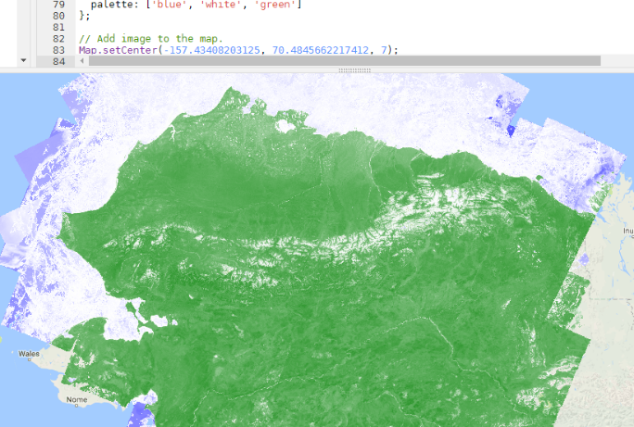
Foliar Cover Overview
Environmental Features
Topographic
Hydrographic
Climatic
Spectral Features
Composite Output
Veg DB
Multi-project data from 1998 to 2017
Distribution (0%)
Train-test split (n=100)
Model Train
Foliar Cover (1-100%)
Classifier
Regressor
Notes:
We modeled foliar cover of six dominant and widespread vascular plant species: Carex aquatilis, Eriophorum angustifolium, Eriophorum vaginatum, Rhododendron tomentosum, Salix pulchra, and Vaccinium vitis-idaea.
We statistically associated species distribution and abundance independently to a suite of 83 topographic, hydrographic, climatic, and multi-season spectral features. Our quantitative measurements informed abundance, and all of the available data informed distribution. We modeled each response type using 100 cross validation iterations with a stratified 30% of the data withheld at random as the independent test partition per iteration. We then composited the responses so that foliar cover was predicted only in areas of predicted species presence.
We conducted the entire modeling workflow within a Bayesian statistical framework to uniquely tune each model to species and response type.

Slide 11
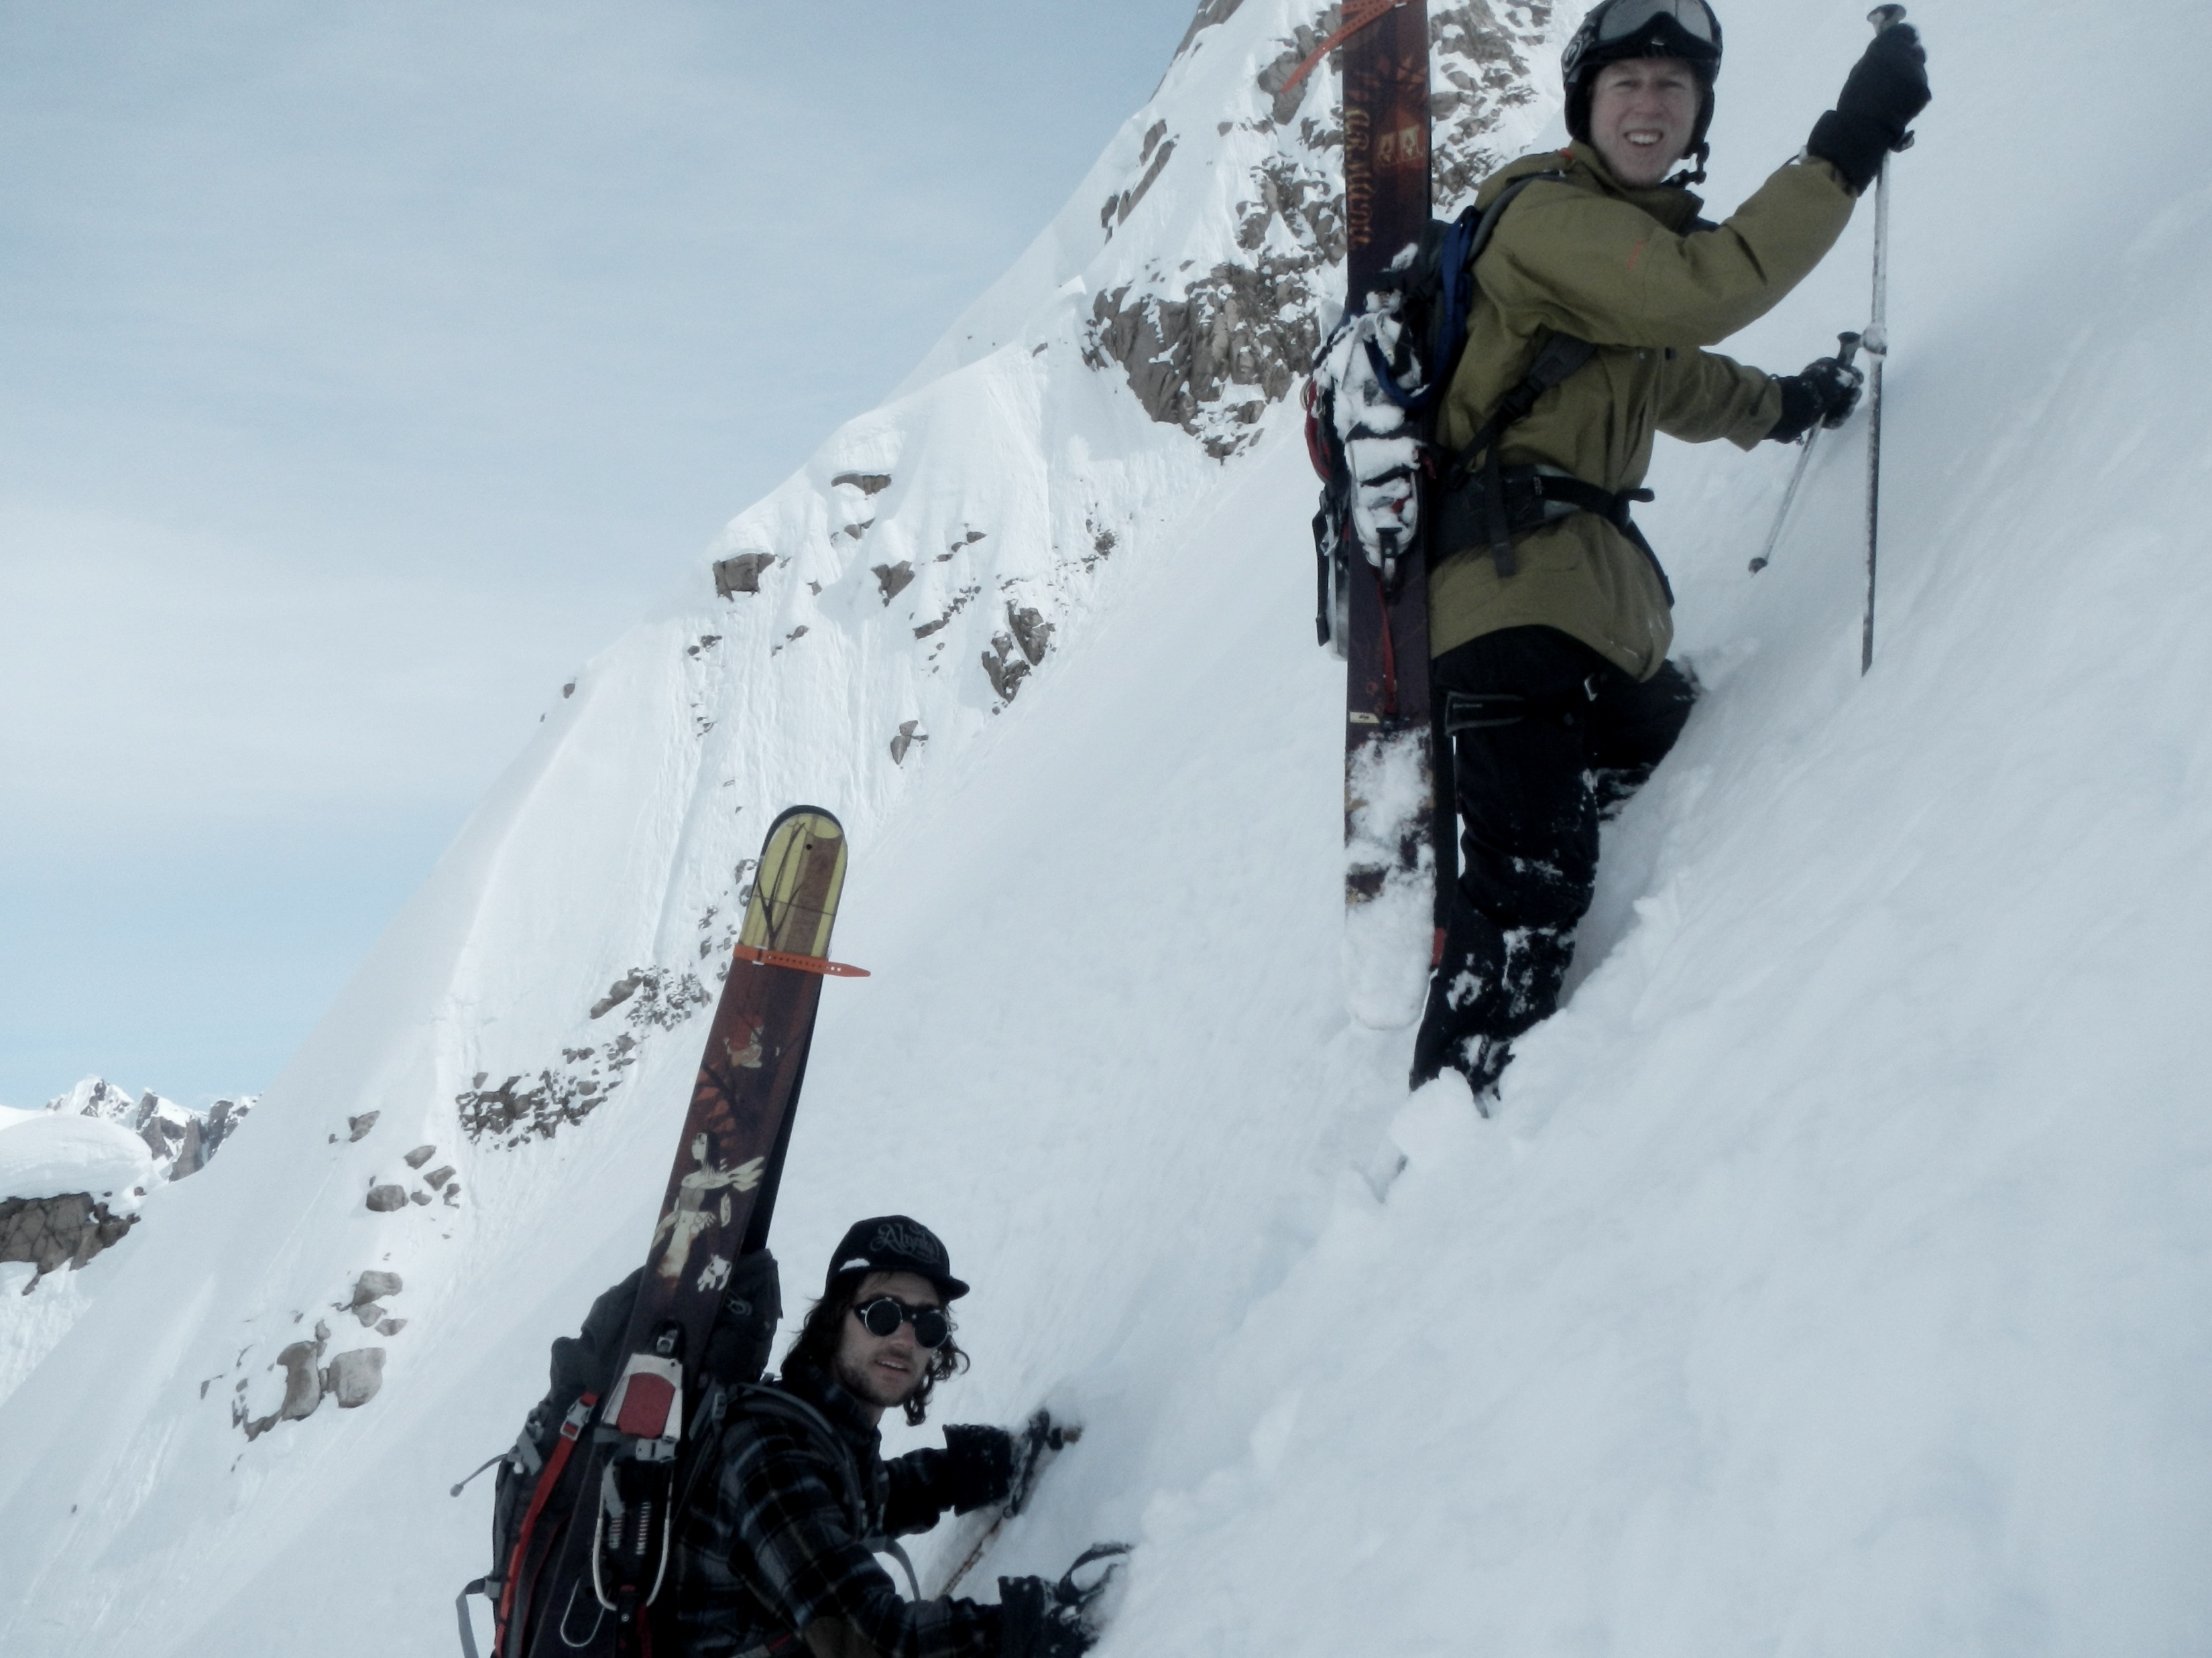
Sequential Weak Learners
Tree n splits
N trees and λ learning rate
Notes:
We selected to model responses using stochastic gradient boosting ensembles because they’re capable of predicting complex patterns of continuous and binary responses from numerous, potentially weak, correlations in relatively small samples. Stochastic gradient boosting is a composite of sequential weak learners, where each learner performs slightly better than random. We selected decision trees with 8 or fewer splits as our weak learners with N total trees and lambda learning rate among other regularization and randomization factors. In the visual example our weak learners are skiers.

Slide 12
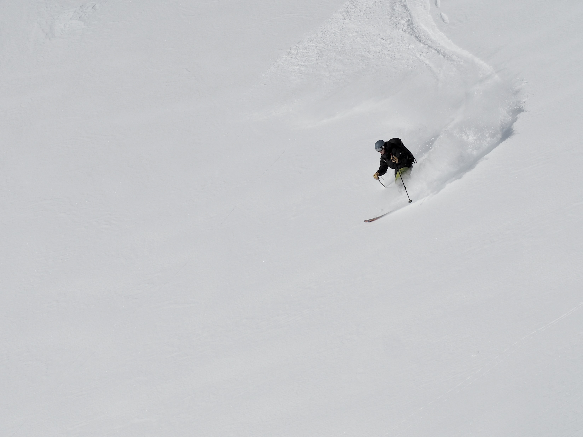
Sequentially fits gradient remaining from combined previous weak learners
distance proportional to negative slope
direction
Notes:
Each weak learner sequentially fits the gradient that remains in the data from the combined previous weak learners, with the direction of each iteration maximizing steepest descent and the distance proportional to negative slope.

Slide 13
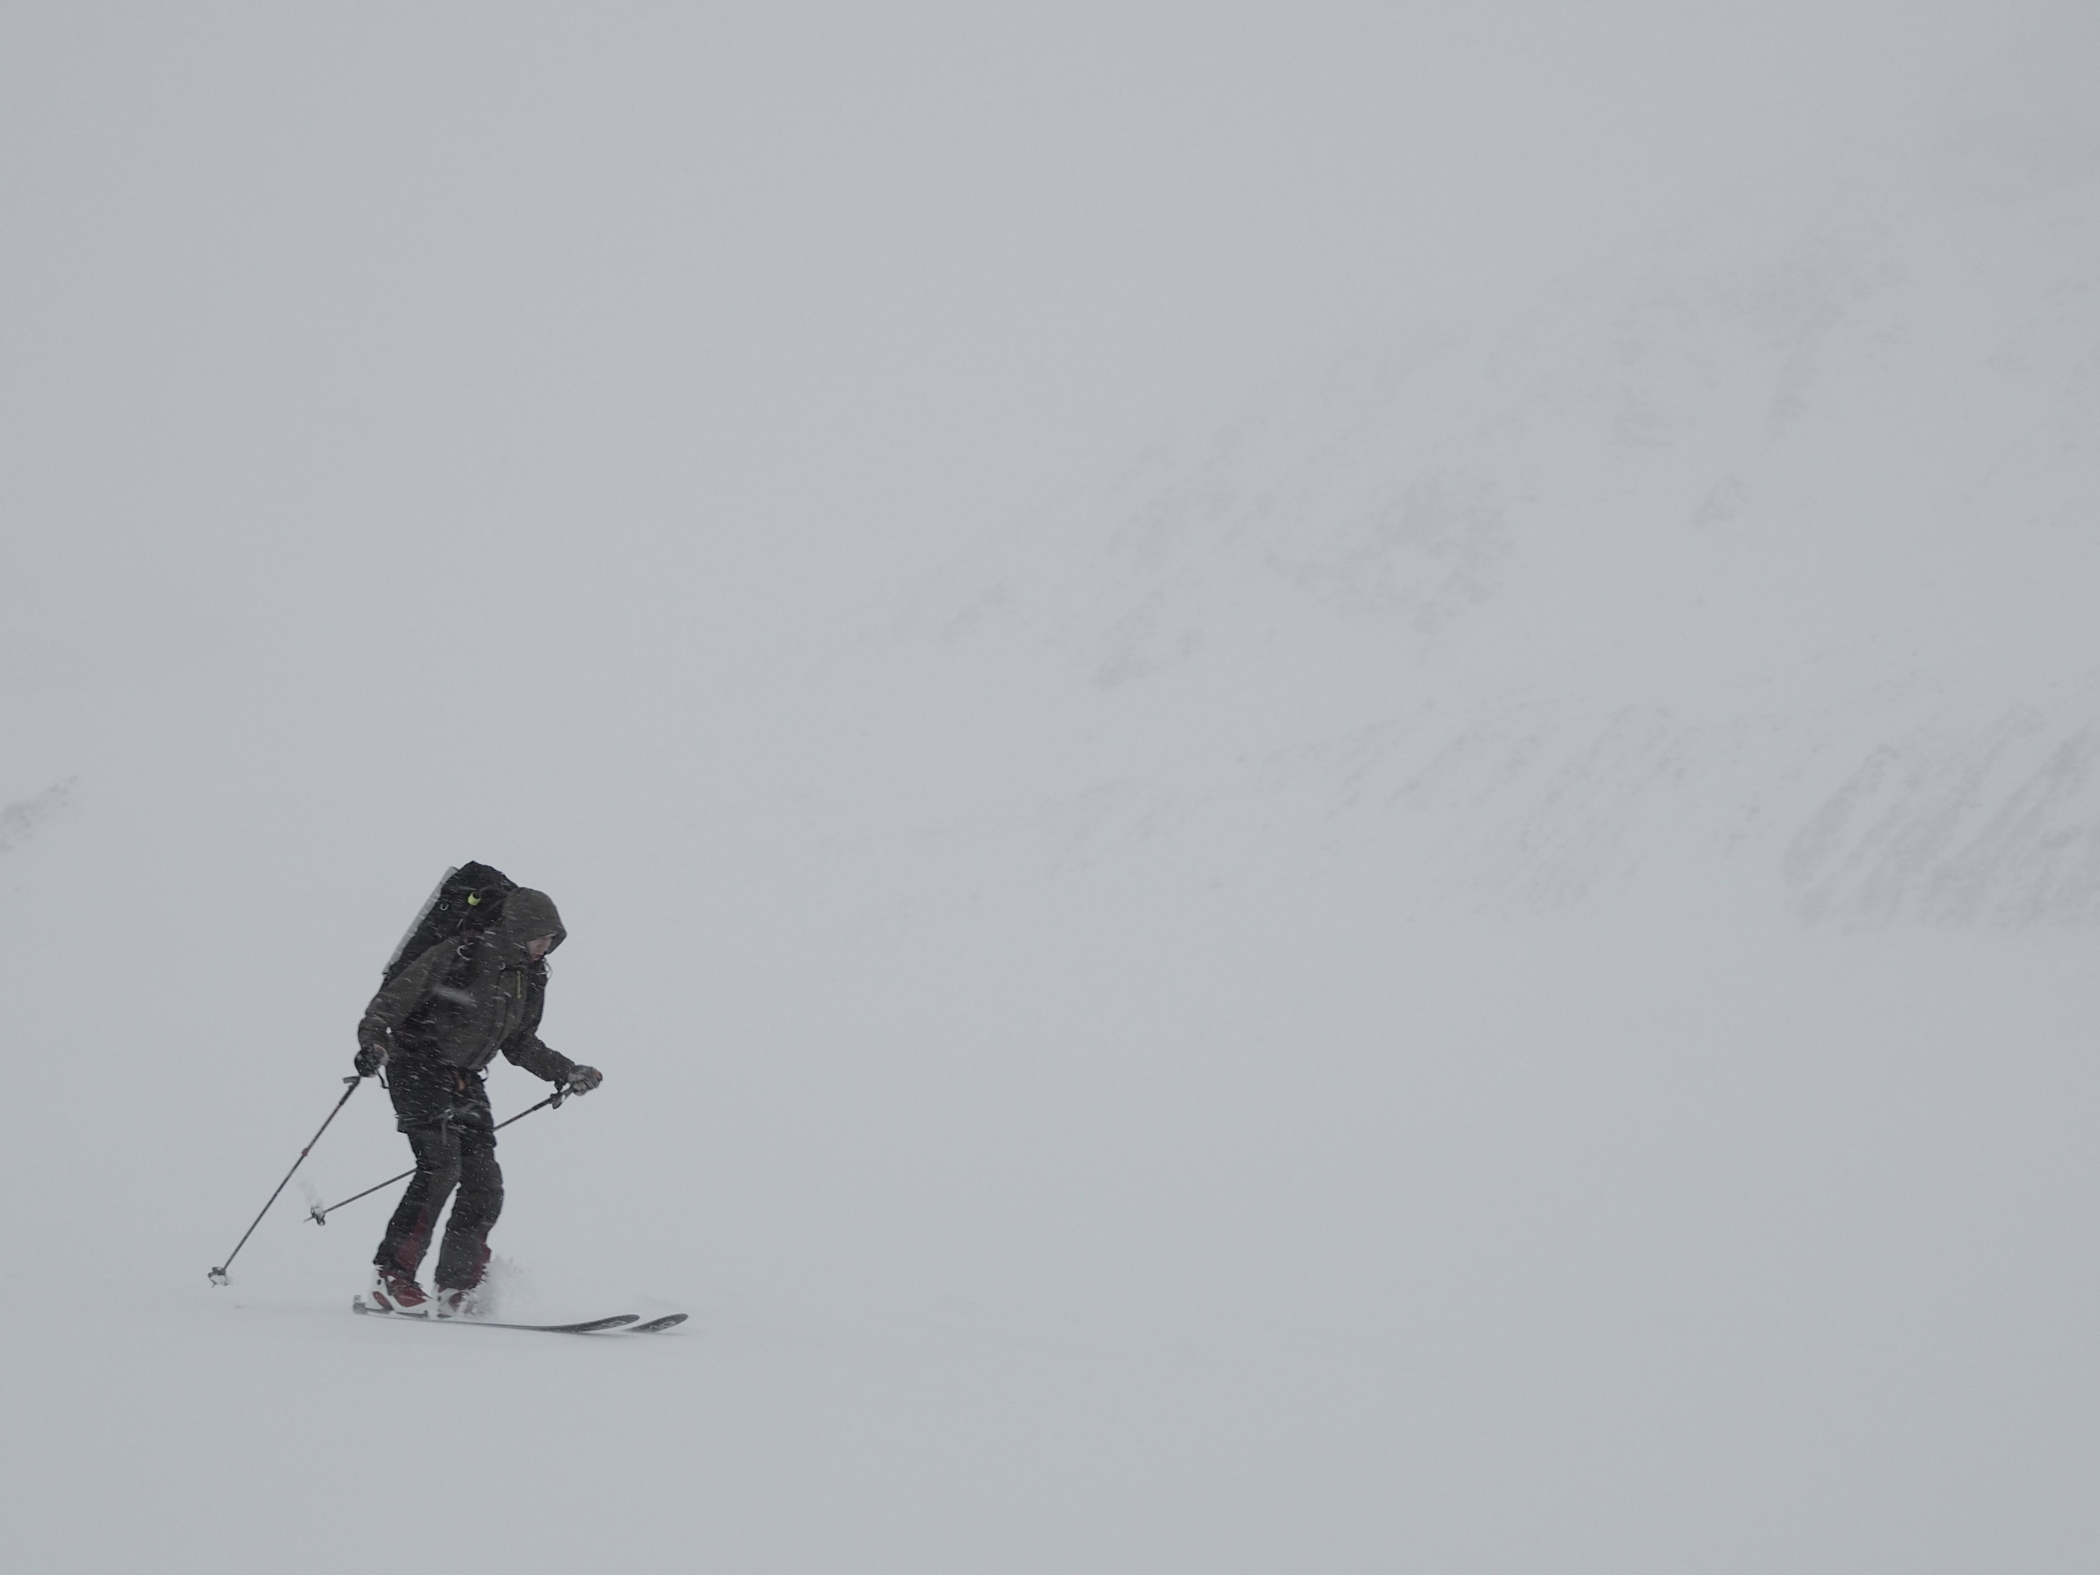
Minimize a loss function to converge on optimal solution
Local Minimum
Notes:
The weak learners descend the gradient to minimize a loss function. In the context of classification, this can be thought of as re-classifying the incorrect classifications. In regression, this can be thought of as repeatedly refitting the residuals. In both cases, the models continuously refit different aspects of the data.

Slide 14
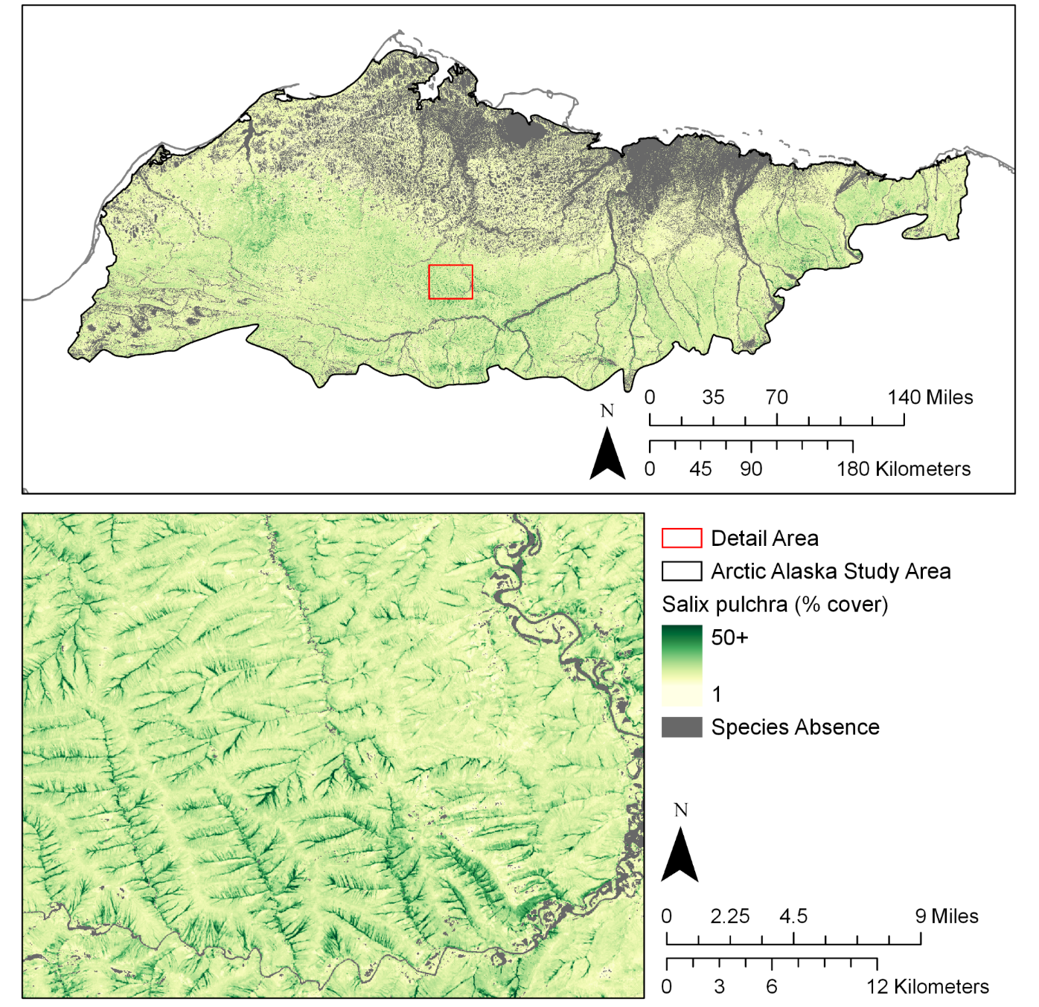
Salix pulchra Results
Overall
R²: 0.65 +- 0.11
MAE: 3.1 +- 0.4
RMSE: 5.4 +- 0.8
Absence
AUC: 0.8 +- 0.01
Acc: 0.72 +- 0.02
Notes:
Our predictions resulted in maps of foliar cover across the study area for five out of six selected species. Our best performing model was Salix pulchra, which predicted 65% of the variation in observed foliar cover with root mean squared error of 5.4%. Our results make sense ecologically, with widespread presence on drained slopes and high-centered polygons and high-abundance along stream corridors in the foothills.

Slide 15
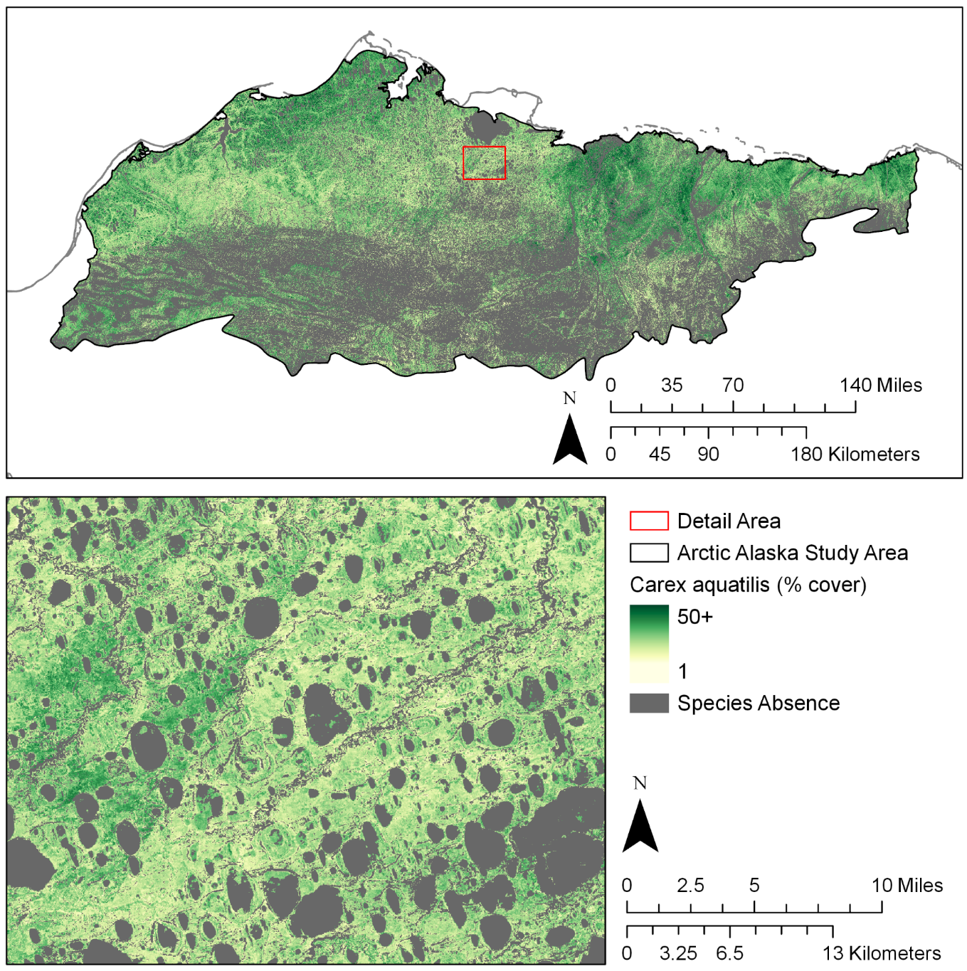
Carex aquatilis Results
Overall
R²: 0.35 +- 0.15
MAE: 9.24 +- 1.2
RMSE: 13.8 +- 1.5
Absence
AUC: 0.86 +- 0.01
Acc: 0.79 +- 0.01
Notes:
Our worst performing model, with the exception of E. angustifolium, which I’ll discuss later, was Carex aquatilis, which predicted 35% of the variation in observed foliar cover with root mean squared error of 13.8%. Again, the results make sense ecologically with Carex aquatilis most abundant on low-centered polygons, and widespread among the wetland features of the coastal plain, but largely absent from the drained slopes of the foothills.

Slide 16
Tussock Tundra Results
Strong correlation (r > 0.8) for species that commonly form communities
Notes:
Despite modeling species individually, our spatial predictions for Eriophorum vaginatum, Rhododendron tomentosum, and Vaccinium vitis-idaea were strongly correlated with each other, which reflects the strong correlation among these species in our observation data. The realized niches of these species overlap to form the Eriophorum vaginatum dominated tussock tundra communities on drained slopes and mesic polygon features. This means that we’re successfully inferring community gradients from the spectral and environmental data.

Slide 17
Comparison to NSSI Map
Linear models to assign foliar cover means to cover classes and predict to the test data (100 cv iterations)
5%
0%
10%
20%
Notes:
To compare to our results to the predictions of a recent discrete type map, the North Slope Land Cover map, we assigned foliar cover means per cover class using linear models in 100 cross validation iterations with 30% of data withheld at random per iteration as the independent test partition.

Slide 18
Species Gradient vs Discrete
Species | Percent of observed spatial heterogeneity predicted
 | North Slope Land Cover Map | Continuous Foliar Cover Predictions
Salix pulchra | 0.13 ± 0.15 | 0.65 ± 0.11
Eriophorum vaginatum | 0.47 ± 0.11 | 0.62 ± 0.10
Vaccinium vitis-idaea | 0.44 ± 0.12 | 0.57 ± 0.12
Rhododendron tomentosum | 0.43 ± 0.10 | 0.57 ± 0.14
Carex aquatilis | 0.11 ± 0.10 | 0.35 ± 0.15
Eriophorum angustifolium | 0.01 ± 0.07 | -0.06 ± 0.19
Species-level gradients significantly outperformed discrete map
Notes:
Doing that gave us an estimate of how well the discrete map reflects species heterogeneity. The middle column shows the predictive performance of the NSSI map and the right column shows the predictive performance of our continuous maps. Neither predicted the variation in observed foliar cover of Eriophorum angustifolium, although the continuous results successfully predicted distribution. We suspect Eriophorum angustifolium was not well-matched to the 30 m scale of these analyses. It often occupies narrow water tracks and other linear wetland features that are much smaller than our prediction grid. The NSSI map performed relatively well for Eriophorum vaginatum and associates, likely because the map classes are biased towards tussock tundra vegetation types. For all species except Eriophorum angustifolium, the continuous maps predicted significantly more of the observed species-level spatial variation. An example of how this might affect natural resource managers is the issue of shrubification: expansion of Salix pulchra will have low change detectability with the discrete map, but relatively high detectability with the foliar cover prediction.

Slide 19
Future Applications
Link spatial and temporal gradients of caribou resource selection to species abundance, phenology, and physical habitat on the North Slope
Inform forage availability for moose in Southwest Alaska
Ultimate goal: production of continuous community gradient allowing post hoc fuzzy membership classification
Notes:
Our next step for this project will be to link our foliar cover predictions to phenology and physical habitat to explore the spatial and temporal relationships of caribou resource selection to the forage species Carex aquatilis, Eriophorum vaginatum, and Salix pulchra in June and July.
We also will begin mapping forage availability for moose in Southwest Alaska.
As a long-term goal, I would like to apply these methods towards the production of a quantitative vegetation community map for Alaska.

Slide 20
Access
Vascular species checklist: https://floraofalaska.org
Lichen and bryophyte checklists: https://akveg.uaa.alaska.edu
Alaska Vegetation Plots Database: https://akveg.uaa.alaska.edu
Project Code: https://github.com/accs-uaa
Geospatial Products: https://accscatalog.uaa.alaska.edu
Notes:
Our species checklists, vegetation plots database, and project code are available online. The geospatial products will be available soon on the ACCS data catalog.

Slide 21
Questions?

Slide 24
Line-Point Intercept
Field Data Collection
50 points per 25 m transect
Cover = unique species hits
Measures 4.71x10⁻⁴ sq m * z
Cover varies with observer

Slide 25
Features
Climate (771 m)
Summer Warmth Index
Growing Season
Date of Freeze
Date of Thaw
Annual Precipitation
Topographic (60 m)
Elevation
Aspect
Slope
Compound Topographic
Heat Load Index
Integrated Moisture
Roughness
Site Exposure
Surface Area Ratio
Surface Relief
Landsat-8 (30 m)
Bands 1-7
EVI-2
NBR
NDMI
NDSI
NDVI
NDWI
Hydrographic (60 m)
Small Stream Distance
Large Stream Distance
Floodplain Distance

Slide 26
Study Area
Statistically define study area:
Support vector 95% of samples in feature space
Project into physical space
Calculate landscape gradient using 1.5 km moving average
Post-process study area:
Largest contiguous region of >= 50%
Convert to smoothed polygon
Manual correction

Slide 27
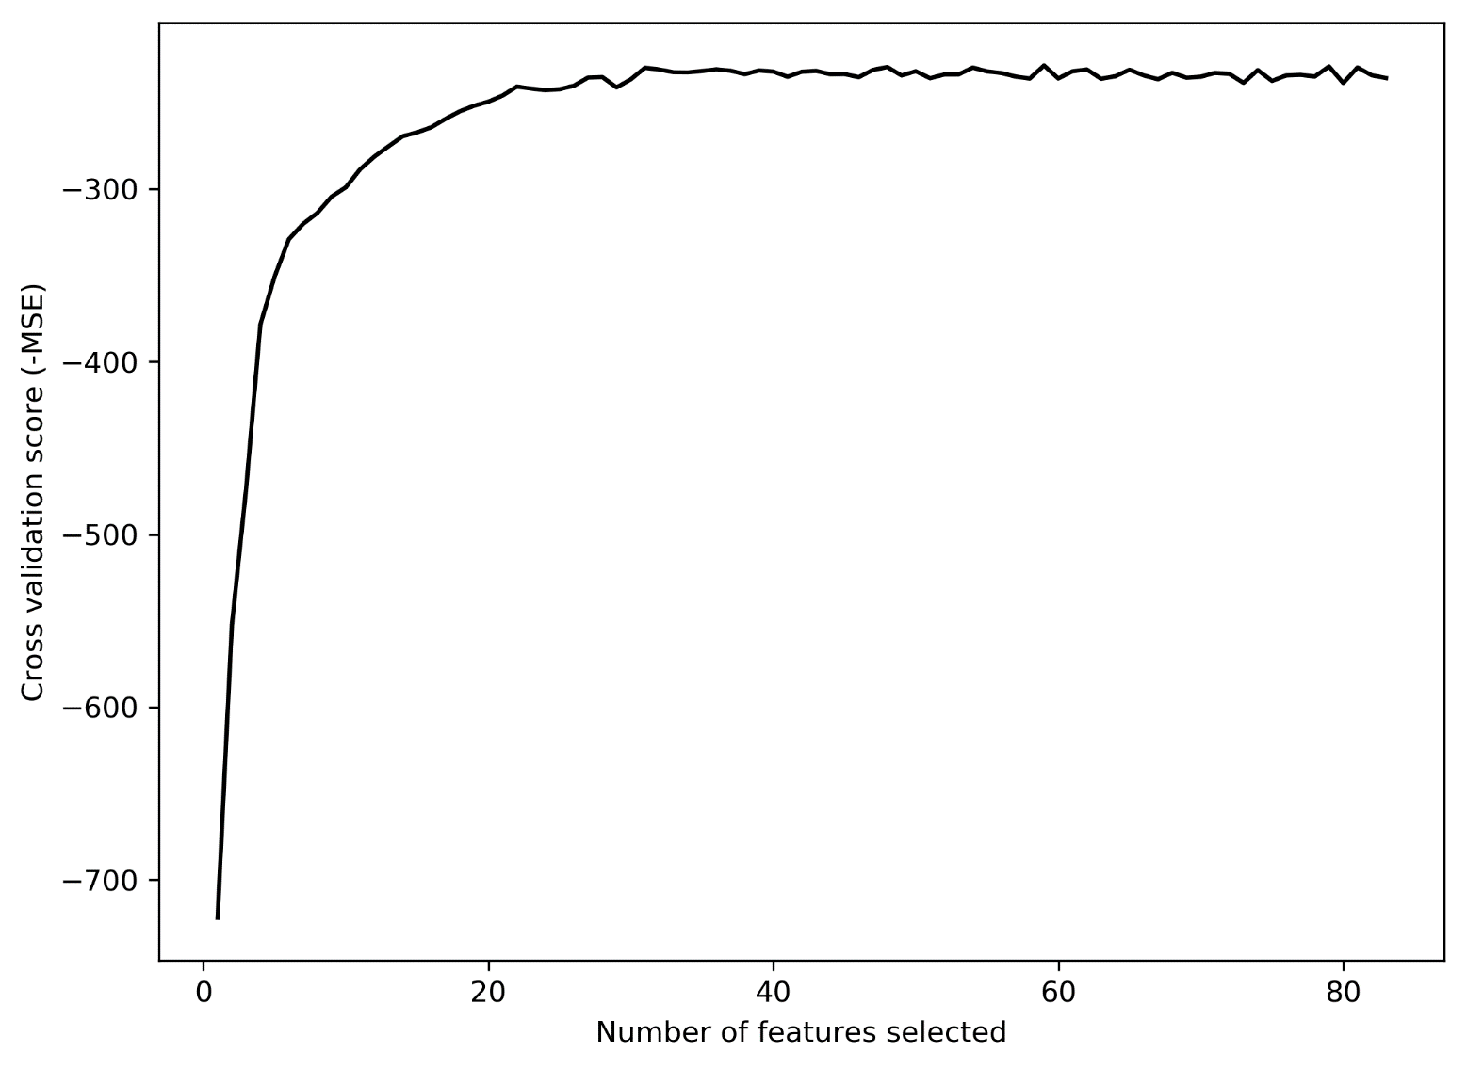
Recursive Feature Elimination
Eliminate least important features to find optimum without multi-model comparisons

Slide 28
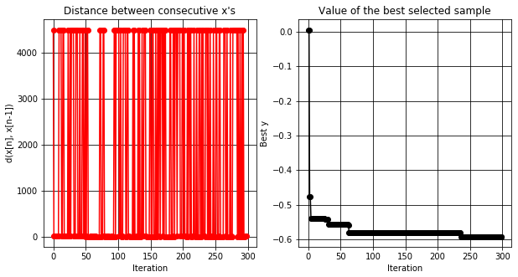
Bayesian Framework
Gaussian process generates [x]
Tune species- and response-specific models without assuming similar data structures

Slide 29
Stochastic Gradient Boosting

Slide 30
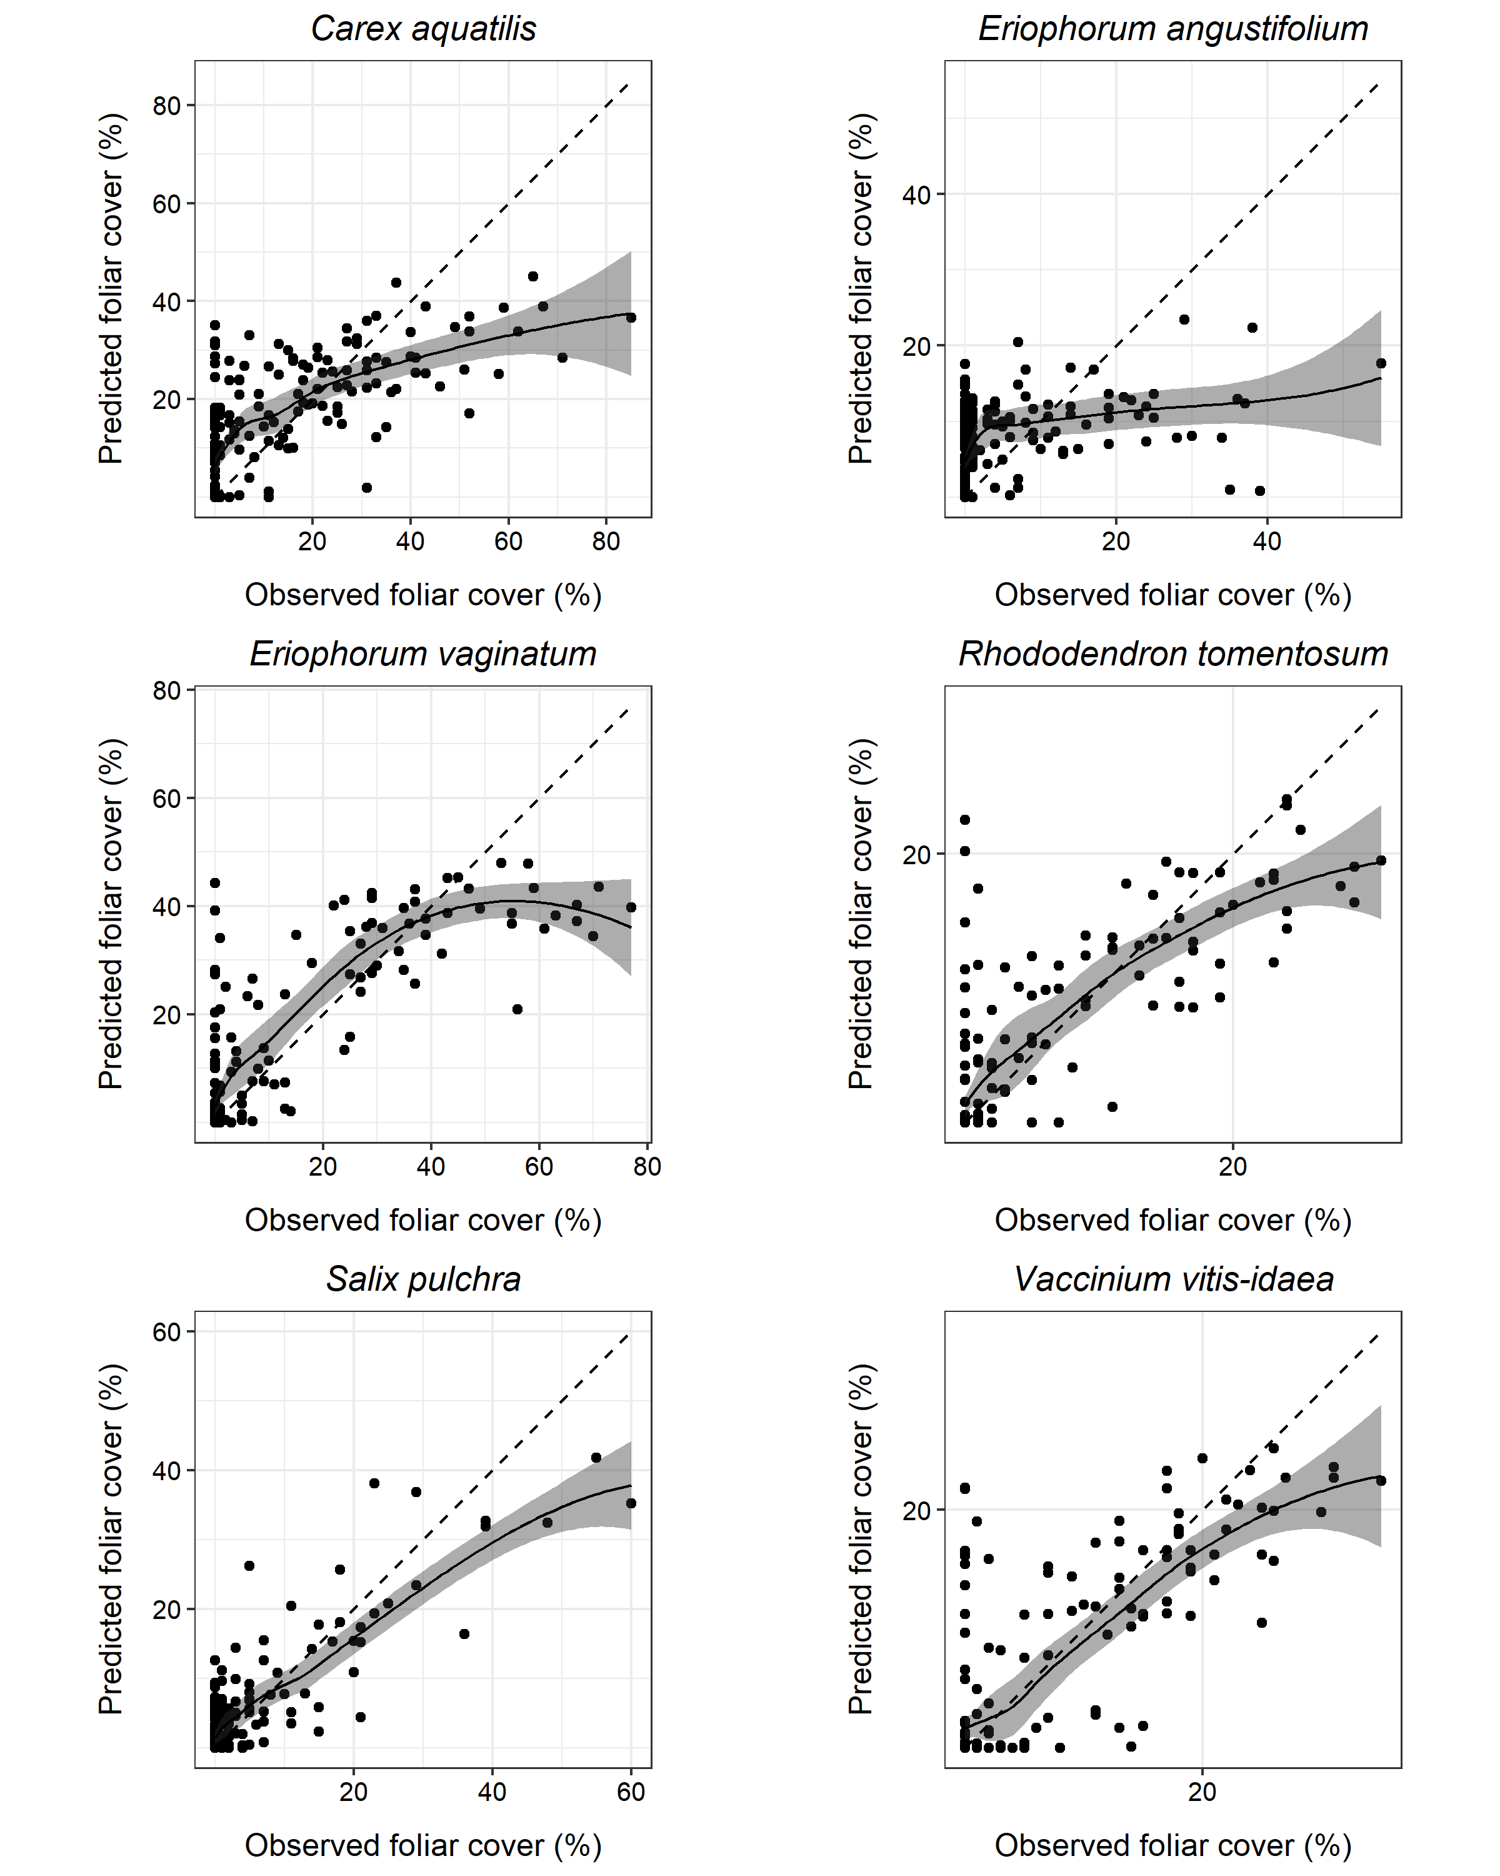
Foliar Cover Results

